Slide 1

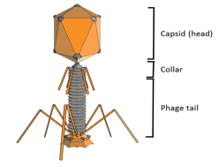
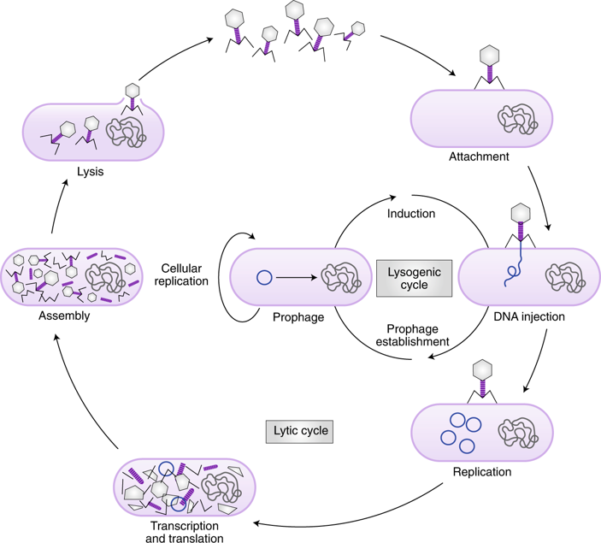
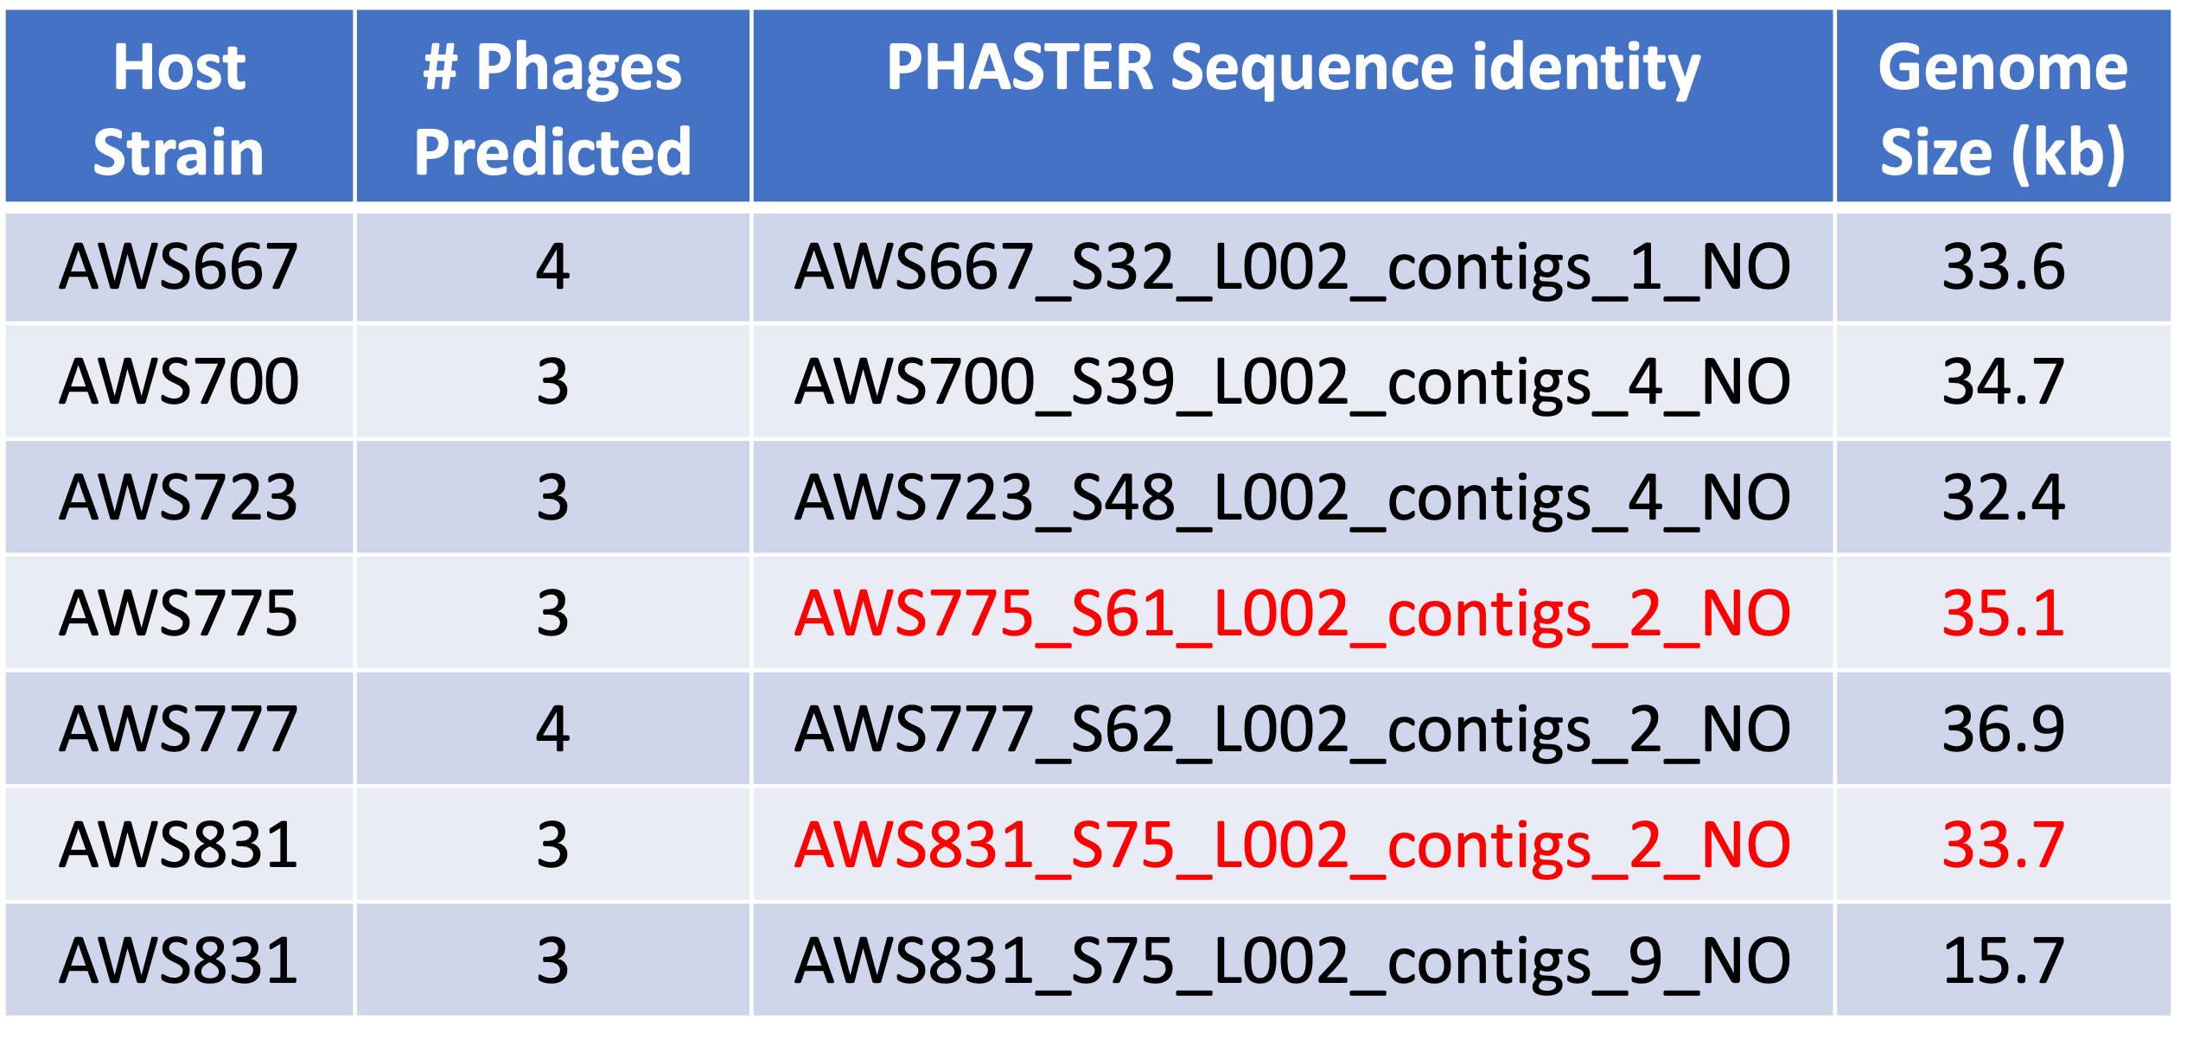
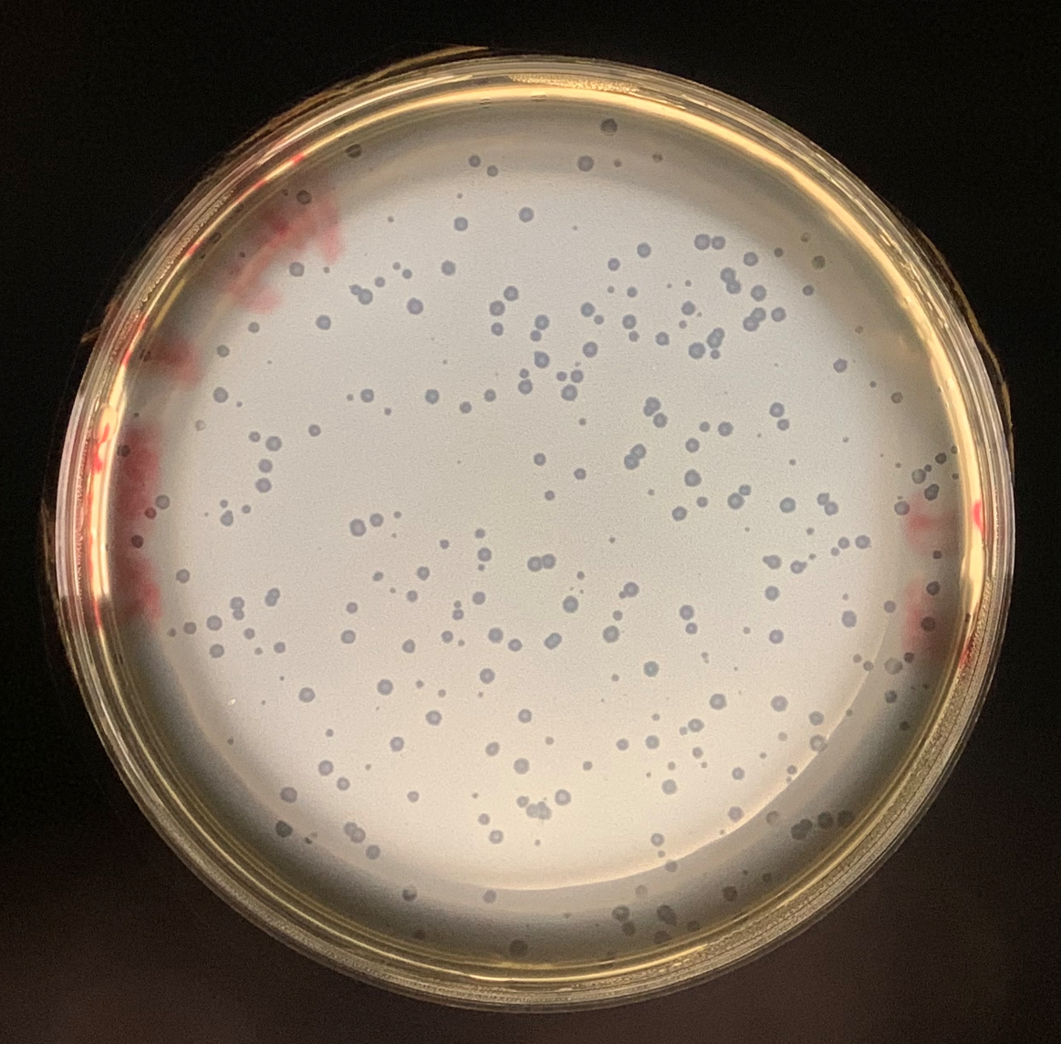
Personalized Medicine Through Personal Data Pods
Elias Crum1,2,∗, Ruben Taelman1, Bart Buelens2, Gokhan Ertaylan2 and
Ruben Verborgh1 1IDLab, Department of Electronics and Information Systems, Ghent University – imec, Belgium 2Flemish institute for Technological Research (VITO) Mol, Belgium
Abstract
Results
Escherichia coli, a well-studied constituent of the urinary microbiome (urobiome), is often associated with urinary tract infections (UTIs). In addition to bacteria including E. coli, the urobiome is also home to bacteriophages (phages), including bacteriophages that infect E. coli (coliphages). Temperate phages, whose role in the urobiome has yet to be explored, persist through two life cycles: the lysogenic life cycle and the lytic life cycle. This project investigates the diversity and inducibility of coliphages within the urobiome to provide insight into their possible role in shaping the urobiome. All publicly available urinary E. coli genomes in NCBI were examined for prophage sequences. Our investigation shows that urobiome coliphages exhibit extensive genomic diversity and can be experimentally induced under stressful environmental conditions.
Goal 1: Phage Network
Background
Phages are viruses that infect bacteria ¹
Phage Lifecycles
Temperate phages modulate bacterial communities ²
Bacteria, particularly E. coli, are implicated in urinary disorders ³
Goal 1: Survey urinary coliphage diversity via prophage prediction
Goal 2: Induced Prophages
Goal 2: Experimentally induce and identify predicted prophages
Induction
* Red denotes 99% similar phage sequences
Conclusions
References
Substantial urinary E. coli prophage diversity observed
Some PHASTER predicted urinary prophages are temperate phages
Induced temperate phages could modulate the bacterial communities in the urinary tract
¹ Ackermann. Methods Mol Biol. 2009.
² De Sordi et al. Cell Host Microbe. 2019.
³ Foxman. Infect. Dis. Clin. North Am. 2014.
⁴ Arndt et al. Nucleic Acids Res. 2016.
⁵ Eren et al. PeerJ. 2015.
⁶ Shapiro et al. Mbio. 2018.
⁷ Shannon et al. Genome Res. 2003.
⁸ Miller-Ensminger et al. PeerJ. 2020a.
Future Directions
Acknowledgements
Investigate lytic potential of induced prophages
Determine impact of genetic engineering on lytic potential
Thank you to Zubia Merchant and Adriana Ene for their contributions. Funding provided by the 2020 LUC Mulcahy Fellowship.

